Slide 1
INTELLIGENT DECISON SUPPORT
(EXPERT SYSTEMS)
(#5)
Prof. Dr. Ercan Oztemel

Slide 2
CONTENTS…
Expert systems

Slide 3
Expert Systems- Definition
It is a computer program which can solve the problems requiring human expertise in the same way as the human expert would do when he/she faces the same problem
An expert system is a software that attempts to reproduce the performance of one or more human experts, most commonly in a specific problem domain

Slide 4
Expert Systems- Definition
Use human knowledge to solve problems that normally would require human intelligence (perform human expert behavior)
Embody some non-algorithmic expertise
Represent the expertise knowledge as data or rules within the computer
Simply called knowledge-based systems

Slide 5
Expert System- Definition
Developed via specialized software tools called shells
Shells come equipped with an inference mechanism
Backward chaining
Forward chaining
Both
May or may not have learning components
They are tested by being placed in the same real world problem solving situation
Key idea: problem solved by applying specific knowledge rather than specific technique

Slide 6
Special Attention
Expert systems provide direct application of EXPERTISE
Expert Systems do not replace experts,
but they
make their knowledge and experience more widely available and
permit non-experts to work better

Slide 7
Expertise
The extensive, task-specific knowledge acquired from training, reading and experience
Theories about the problem area
Hard-and-fast rules and procedures
Rules (heuristics)
Global strategies
Facts
Meta-knowledge (knowledge about knowledge)
Enables experts to be better and faster than non-experts

Slide 8
Expert
An expert has the special knowledge, judgment, experience and methods to give advice and solve problems
He/she provides knowledge about certain task performance.

Slide 9
Human Expert Behaviors
Recognize and formulate the problem
Solve problems quickly and properly
Explain the solution
Learn from experience
Restructure knowledge
Break rules
Determine relevance
Degrade gracefully

Slide 10
Capabilities of Expert Systems (1)
Can…
Display intelligent behavior
Draw conclusions from complex relationships
Consistent answers for repetitive decisions, processes and tasks
Explain their reasoning or suggested decisions
Never "forgets" to ask a question, as a human might
Provide portable knowledge
Expert system shell
A collection of software packages and tools used to develop expert systems

Slide 11
Capabilities of Expert Systems (2)
Strategic goal setting
Explore impact of strategic goals
Planning
Impact of plans on resources
Design
Integrate general design principles and manufacturing limitations
Decision making
Provide advise on decisions
Quality control and monitoring
Monitor quality and assist in finding solutions
Diagnosis
Look for causes and suggest solutions

Slide 12
Limitations of Expert Systems
Lacks common sense
Limited to relatively narrow problems
Possibility of error in the knowledge base
Cannot refine own knowledge base
Cannot make creative responses as human expert
Cannot adapt to changing environments
Difficult to maintain
May have high development costs
Domain experts not always able to explain their logic and reasoning

Slide 13
Objectives and Activities of Expert Systems
Objectives
To transfer expertise from an expert to a computer system and
Then on to other humans (non-experts)
Activities
Knowledge acquisition
Knowledge representation
Knowledge inferencing
Knowledge transfer to the user
Knowledge is stored in a knowledge base

Slide 14
Properties of an Expert System
Goal driven reasoning or backward chaining - an inference technique which uses IF THEN rules to repetitively break a goal into smaller sub-goals which are easier to prove
Coping with uncertainty - the ability of the system to reason with rules and data which are not precisely known
Data driven reasoning or forward chaining - an inference technique which uses IF THEN rules to deduce a problem solution from initial data
Knowledge representation - the way in which the problem specific knowledge in the system is stored and accessed
User interface - that portion of the code which creates an easy to use system
Explanations - the ability of the system to explain the reasoning process that it used to reach a recommendation.

Slide 15
Components of an Expert System

Slide 16
Expert Systems Types
Rule-based Expert Systems
Frame-based Systems
Hybrid Systems
Model-based Systems
Ready-made (Off-the-Shelf) Systems
Real-time Expert Systems

Slide 17
Knowledge Acquisition
Knowledge acquisition is the accumulation, transfer and transformation of problem-solving expertise from experts and/or documented knowledge sources to a computer program for constructing or expanding the knowledge base
Requires a knowledge engineer

Slide 18
Knowledge Base
Knowledge base contains the knowledge necessary for understanding, formulating, and solving problems
Knowledge is the primary raw material of ES
Incorporated knowledge representation (Stores all relevant information, data, rules, cases, and relationships used by the expert system)
Uncertainity
allowing shades of gray and does not require everything to be simply yes/no, or true/false
Two Basic Knowledge Base Elements
Facts
Special heuristics, or rules that direct the use of knowledge
A conditional statement that links given conditions to actions or outcomes

Slide 19
Inference Engine
The brain of the ES
The control structure (rule interpreter)
Provides methodology for reasoning through seekng information and relationships from the knowledge base and providing answers, predictions, and suggestions in the way a human expert would
Inferencing methodologies
Backward chaining
A method of reasoning that starts with conclusions and works backward to the supporting facts
Forward chaining
A method of reasoning that starts with the facts and works forward to the conclusions
Hybrid chaining

Slide 20
Inference Engine - Major Elements
Interpreter
Scheduler
Consistency Enforcer

Slide 21
Example
Someone is 25 year old and has 10000 $ ?
What should he do with his money?

Slide 22
Sample- Rule Base
R1- IF someone has more than 10000 $ and has a university degree
THEN he should make an investment
R2- IF someone has an annual income of at least 40000 $ and has a university degree
THEN he should buy stock exchange
R3- IF someone is less than 30 and he makes an investment
THEN he should buy stock exchange
R4- IF someone is less than 30 and over 22
THEN he has a university degree
R5- IF someone wants to buy stock exchange
THEN he should buy IBM stocks

Slide 23
Sample- Rule Base
A: Has more than 10000 $
B: Is less than 30 years old
C: Has university degree
D: Annual invome is at least 40000$
E: Make investment
F: Buy stock exchange
G: Buy IBM Stock
R1- IF A and C THEN E
R2- IF D and C THEN F
R3- IF B and E THEN F
R4- IF B THEN C
R5- IF F THEN G

Slide 24
Forward Chaining
Use facts avaliable to solve the problem.
Problem: Where to spend the money?
B
A
R1
R3
E
E
R4
C
B
C
R5
F
F
G
G
R4
B
C
R2
D

Slide 25
Backward Chaining
Checks if any there is any fact satisfying s certain goal.
Goal: Can he buy IBM stocks?
B
A
R1
?
R3
E
E
R4
C
B
C
?
R5
F
F
G
G
R4
B
C
?
?
R2
D

Slide 26
User Interface
Handles the communication between the user and expert systems
Encompassing a language processor for friendly, problem-oriented communication (NLP, or menus and graphics)
Provides explanation capability

Slide 27
Explanation Capability
Traces responsibility and explains the Expert System behavior by interactively answering questions
-Why?
-How?
-What?
-(Where? When? Who?)
Knowledge Refining System
Learning for improving performance

Slide 28
Expert Systems Development

Slide 29
Participants in Expert Systems Development and Use
Domain expert
The individual or group whose expertise and knowledge is captured for use in an expert system
Knowledge user
The individual or group who uses and benefits from the expert system
Knowledge engineer
Someone trained or experienced in the design, development, implementation, and maintenance of an expert system
Programmer
Someone who creates the user interface, knowledge base and inference engine and other parts of the expert systems
Knowledge engineer and the programmer might be the same person
Depending on the size of the project

Slide 30
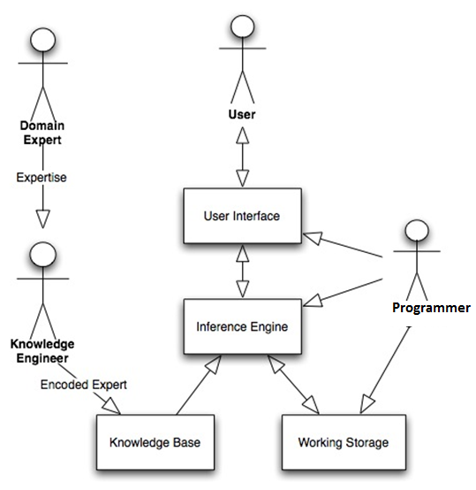
Components and Human Interfaces

Slide 31
Major Roles of Individuals
Domain expert – currently experts solving the problems the system is intended to solve
Knowledge engineer - encodes the expert's knowledge in a declarative form that can be used by the expert system
User - will be consulting with the system to get advice which would have been provided by the expert
Systems built with custom developed shells for particular applications:
Programmer- the individual who builds the user interface, designs the declarative format of the knowledge base, and implements the inference engine (system analyst and network experts may also considered in this category)

Slide 32
Rules for a Credit Application
Mortgage application for a loan for $100,000 to $200,000
If there are no previous credits problems, and
If month net income is greater than 4x monthly loan payment, and
If down payment is 15% of total value of property, and
If net income of borrower is > $25,000, and
If employment is > 3 years at same company
Then accept the applications
Else check other credit rules

Slide 33
Explanation Facility
A part of the expert system that allows a user or decision maker to understand how the expert system arrived at certain conclusions or results
System knows which rules were used during the inference process

Slide 34

Knowledge Acquisition Facility
Provides a convenient and efficient means of capturing and storing all components of the knowledge base
Knowledge base
Knowledge acquisition facility
Expert

Slide 35
Expert Systems Benefits
Increased Output and Productivity
Decreased Decision Making Time
Increased Process(es) and Product Quality
Reduced Downtime
Capture Scarce Expertise
Flexibility
Easier Equipment Operation
Elimination of Expensive Equipment
Operation in Hazardous Environments
Accessibility to Knowledge and Help Desks

Slide 36
Expert Systems Benefits
Integration of Several Experts' Opinions
Can Work with Incomplete or Uncertain Information
Provide Training
Enhancement of Problem Solving and Decision Making
Improved Decision Making Processes
Improved Decision Quality
Ability to Solve Complex Problems
Knowledge Transfer to Remote Locations
Enhancement of Other MIS

Slide 37
Disadvantages of Expert Systems
Knowledge is not always readily available
Expertise can be hard to extract from humans
Each expert’s approach may be different, yet correct
Hard, to work under time pressure (even for a highly skilled expert)
ES users have natural cognitive limits
Most experts have no independent means to validate their conclusions
Experts’ vocabulary often limited and highly technical
Knowledge engineers are rare and expensive
Lack of trust by end-users
Knowledge transfer subject to a host of perceptual and judgmental biases
ES may not be able to arrive at valid conclusions
ES sometimes produce incorrect recommendations

Slide 38
Problems Addressed by Expert Systems
Interpretation systems
Prediction systems
Diagnostic systems
Design systems
Planning systems
Monitoring systems
Debugging systems
Repair systems
Instruction systems
Control systems

Slide 39
Expert Systems Applications
Diagnostic applications, servicing:
People
Machinery
Play chess
Make financial planning decisions
Configure computers
Monitor real time systems
Underwrite insurance policies
Perform many other services which previously required human expertise

Slide 40
A BUSINESS EXAMPLE

Slide 41
Statıstıcal Process Control Expert- XPC
XPC is designed to perform statistical process control over an injection moulding machine which is capable of assuring the quality for producing seal to be used in car production companies.
It can perform preventive control trying to identify problems before actuall happen.
The main aim of the system is to identify whether the process is statistically under control or not.
It can provide some corrective actions to understand and prevent out of cotrol situations.
It may also perform fault diagnosis and provide recommendations to overcome.

Slide 42
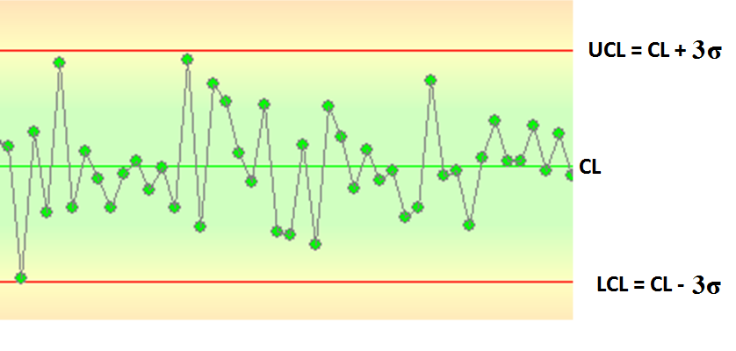
Control Chart

Slide 43
XPC-System Architecture

Slide 44
XPC- Development Team
2 Production Engineer
1 Quality Engineer
1 Knowledge engineer (Industrial Engineer)
2 Foremen

Slide 45
XPC- Knowledge Acquisition
Knowledge collection
Face to face meetings
Discussions and focus groups
General knowledge from the books
Cause and effect analysis

Slide 46
XPC- Knowledge Base
Knowledge base of XPC comprises of SPC knowledge as well as respective process knowledge.
In total; there are 230 Rules, 20 Rule Sets, 340 Knowledge Frames, 1 Classes, 29 Procedures.
An Example Rule:
IF consecutive 7 measured values are above the central line (grand average) then the process is out of control

Slide 47
XPC- Knowledge Base
XPC deals with various out of control situations using respective rules. It also provides some information regarding the out of control situsations. AS an example take the Rule in the previous slide;
IF 7 consecutive measured values are above the central line; THEN possible reason to that;
Non-conformance to planned maintenance
Taking the measurements in different places
Using different pyrometers
Faulty Thermocouple
Uncalibrated equipment use
Changes in material composition
Changes in ambient temperature
Untrained operator

Slide 48
XPC- Knowledge Frame
Name: Job_Type Long Name: Type Text Values: Chart_ Construction; On-line_Use, Chart_Update Question: What kind of Job to be performed? Explanation: Please select the type of Job to be performed by XPC using the arrow keys. Expansion: - This choice allows XPC to perform chart construction - This choice allows XPC to perform on-line monitoring - This choice allows XPC to perform chart update - Interpretation Result:

Slide 49
XPC- Knowledge Frame
When the frame in pervious slide is executed. The screen apperas to be the following..
What kind of Job to be performed?
Chart_Construction
On-line_Monitoring | This choice allows XPC to perform on-line monitoring
Chart_Update
Please select the type of Job to be performed by XPC using the arrow keys.

Slide 50
XPC- Inference Engine
XPC employs backward chaining with opportunistic forward chaining.
Fırst; XPC tries to fire (execute) as many rule as possible in order to produce new knowledge and make a decision. If no decision is reached then the system ask some extra information from the operator and use forward chaining to reach a conclusion about the in or otu of control state of the process and recommend some corrective actions if needed.

Slide 51
XPC- User Interface
XPC provides a user firendliy interface in order to handle the communication with operator.
The user interface is used to obtain extra information and provide graphical representation of the data (25 last mesaurement) in control chart format.
It also perform usual explanation facilities.

Slide 52
Statıstıcal Packages
This is a software performing usual statistical calculations such as calculating the mean, standard deviation, minimum and maxsimum values, etc.

Slide 53
XPC- Functional Components
XPC
CHART
CONSTRUCTION
PROCESS CAPABILITY ANALYSIS
ON-LİNE MONITORING
CHART UPFATE
DIAGNOSIS

Slide 54
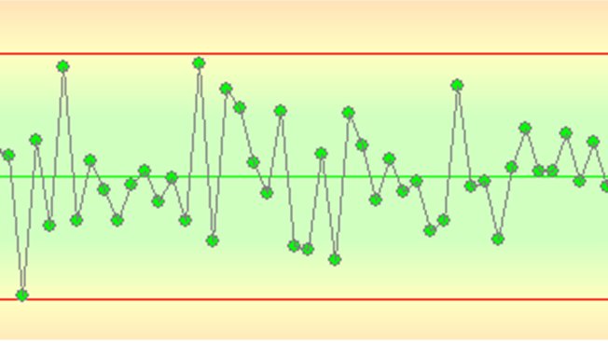
XPC- Chart Construction
Grand Average (CL)
Standard Deviation (σ)
Upper Control Limit (UCL)
Lower Control Limit (LCL)

Slide 55
XPC- Chart Construction
Mean Chart is used together with the Range chart. Btoh should be statistically in control in order to sustain the quality.
The range (r) is the difference between maxiumu and minimum value of each sample.
XPC cacluates grand Range Average (R_{ort}) as usual.

Slide 56
XPC- Chart Construction
Where D3 and D4 indicate the normal range limits defined in accordance with sample size and tabulated in the statistical books. For the sapmle size of 5; D4=2.11, D3=0.

Slide 57
XPC- Chart Construction
Measured values of the process
Removing out of control measures
Calculating the parameters of control chart
Defining the draft limits
Setting up the chart and drawing the measured values
Interpreting the chart
Process is in control
Process is out of control
New Value
Process Capablity analysis
No
Yes

Slide 58
XPC- Process Capability Analysis
XPC is able to perform process capability analysis using the grand average, (CL) standard deviation (σ) and customer tolerances both lower (LTL) and upper (UTL) limits. It calculates process capability indexes as such;
Process capability index (Cp)= (UTL-LTL)/6*σ
Upper Limit Capability indek (Cpu)= (UTL-CL)/3*σ
Lower Limit Capability index (Cpk)= (CL-LTL)/3*σ
(Cp),(Cpu),(Cpk) are all should be equalt to 1 or be above in order to make sure that the process is aligned with the customer specifications. Otherwise the either the tolerances should be updated or the problem should be sorted out and the chart should be reconstructed.

Slide 59
XPC- Process Capability analysis
Chart Contruction
Chart construction or update
No
Yes
Chage Tolerances
Calculating capability indexes
Analysing the data distrbution
Tolerance analysis
Process is capable
Process is incapable
On-line monitoring

Slide 60
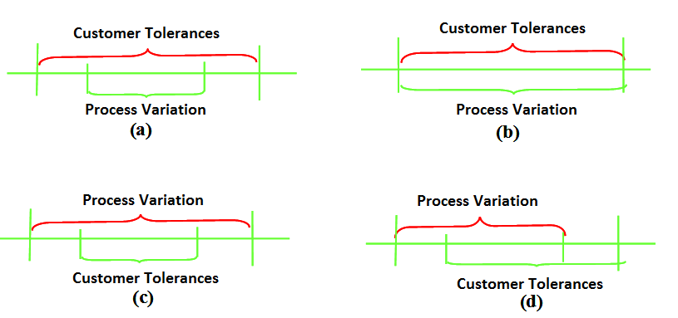
XPC- Process Capability Analysis

Slide 61
XPC- On-line Monitoring
On-line measurements
Statistical calculation
Graphical representation
Automatic interpretation
Process is in control
Process is out of control
İdentify out of control situation
İdentify possible causes
Set up recommendation
Detail Analysis?
No
Yest
Perform Fault Diagnosis
Perform Fault Analysis

Slide 62
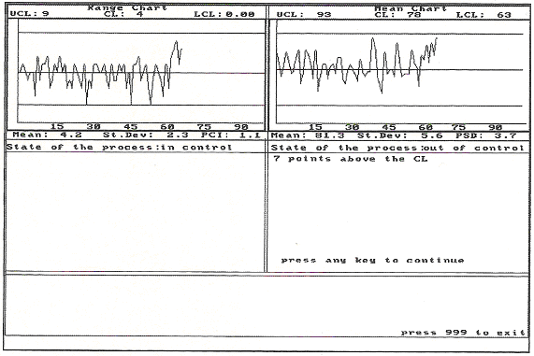
XPC- Example Screen Shot

Slide 63
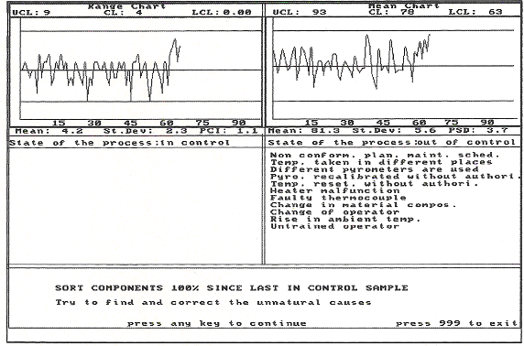
XPC- Example Screen Shot

Slide 64
XPC- Chart Update
Last measurements of the process
Remove out of control measures
Identifying the chart parameters
Setting up the chart and drawing the measurements
İnterpreting the chart
Process is in control
Process is out of control
Process capability analysis

Slide 65
Conclusion
It is proven that computers can perform intelligent operations. Expert systems are well-known and well accepted by Business
Expert Systems can be a beneficial tool for generating Business intelligence.
The example XPC explained is;
an example of Expert System Application performing the expertise of statistical process control.
used is successfully used in an injection molding process
İs proven to be a good source of process improvement.
Similar to XPC; it is possible to generate expert systems for various manufacturing functions including design, process control, production planning etc.

